Slide 1


Comparing the Performance of Depth First Search and Breadth First Search for a Robot with Energy Constraints Exploring an Unknown Environment
Shyam Rajendren
CIS 6913 – Research Methods in Computing
School of Computing
University of North Florida

Slide 2
Problem Statement
There are many algorithms that can be used to help a robot traverse an unknown environment but when selecting an algorithm for a robot we would like to pick the one which performs the best
Depth First Search (DFS) [1] and Breadth First Search (BFS) [5] will be compared
Four evaluation metrics: time taken, energy consumed, number of trips, percentage of unexplored points

Slide 3
motivation
In many scenarios we must rely on robots to explore environments which humans cannot
Very few algorithms consider a robot’s energy constraint

Slide 4
Previous work
Multiple robots by Mishra et. al [7]

Slide 5
methodology
Goal
Environment
Traversal
Important points to consider

Slide 6
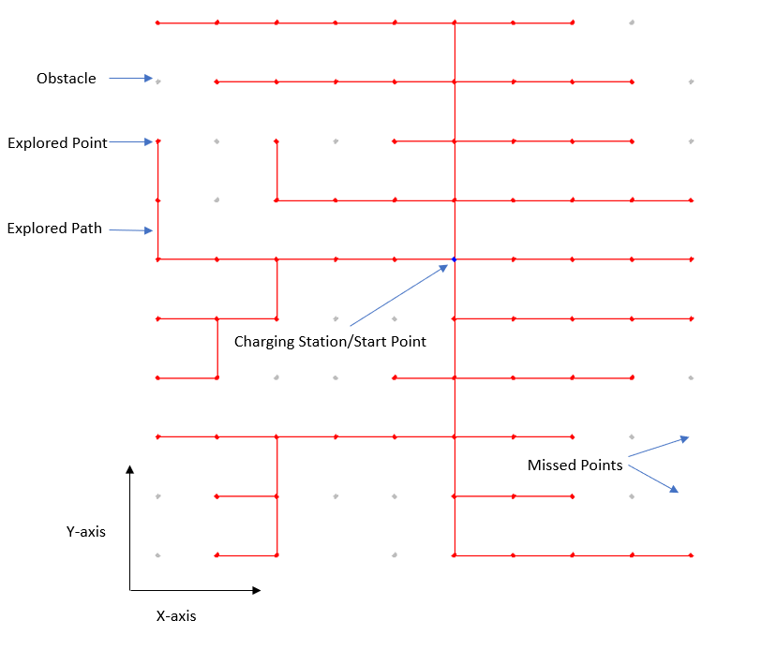
methodology

Slide 7
evaluation
Three environments: 10x10, 50x50, 100x100
Three obstacle percentages: 10%, 20%, 30%
Environments created using GraphStream [3]
Four evaluation metrics (time taken, energy consumed, number of trips, percentage of unexplored points) explained

Slide 8
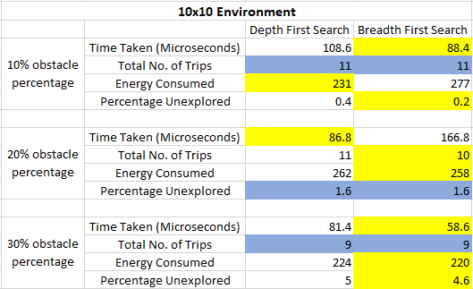
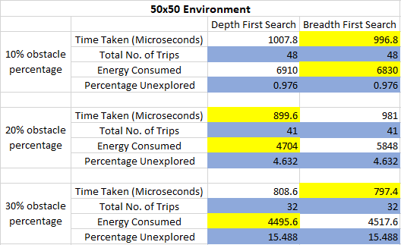
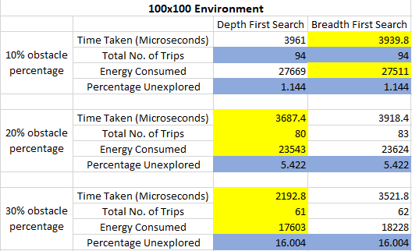
results

Slide 9
conclusion
DFS and BFS perform essentially the same
Results are as expected
Conclusion

Slide 10
Future work
T-tests
Implement algorithms in a real-world environment

Slide 11
references
[1] Charles Pierre Tr ́emaux (1859–1882) ́Ecole polytechnique of Paris(X:1876), French engineer of the telegraph in Public conference, De-cember 2, 2010 – by professor Jean Pelletier-Thibert in Acad ́emie deMacon (Burgundy – France)
[2] Grant P. Strimel and Manuela M. Veloso. 2014. Coverage planning withfinite resources.2014 IEEE/RSJ International Conference on IntelligentRobots and Systems(2014), 2950–2956
[3] GraphStream - A Dynamic Graph Library.[online] Available at:https://graphstream-project.org/
[4] Judea Pearl, Heuristics–Intelligent Search Strategies for Computer Prob-lem Solving,Addison-Wesley, Reading, Massachusetts (1984)
[5]K.Zuse:DerPlankalk ̈ulArchived12May2015attheWaybackMachine.PhDthesis,1945.Lastaccessedfrom:https://web.archive.org/web/20150512112136/http://herbscorner.lepete.de/upload/plankalkuel on 11/30/2020.
[6] Moore, Edward F. (1959). ”The shortest path through a maze”. Proceed-ings of the International Symposium on the Theory of Switching. HarvardUniversity Press. pp. 285–292
[7] Saurabh Mishra, Samuel Rodr ́ıguez, Marco Morales, and Nancy M.Amato. 2016. Battery-constrained coverage. InCASE. IEEE, 695–700

